Slide 1
Oncoplastic Techniques For Partial Breast Reconstruction
Annual Congress of National Cancer Institute – Cairo University
Cristiano Boneti, MD, FACS Plastic Surgery and Oncology Cancer Institute of America, Los Angeles

Slide 2
Disclosures
Consulting Agreement - AirXpanders
Consulting Agreement - Allergan

Slide 3
Delayed or Secondary Partial Breast Reconstruction
Defining The Challenge: Radiation Changes

Slide 4
Radiation Therapy
Alone Or In Combination With Other Treatments → Responsible For Up To 40% Of Cancer Cures
70% Of All Cancer Patients Receive Radiation Therapy
In The USA, Approx. 20% Of Population Has Or Will Receive Radiotherapy

Slide 5
Operative Risks After XRT
Complications After Radiation Therapy Occur In Up To 60 % Of Surgical Patients
Marks JE, Freeman RB, Lee F, Ogura JH: Pharyngeal wall cancer: an analysis of treatment results complications and patterns of failure. Int J Radiat Oncol Biol Phys 1978, 4: 587-593. 10.1016/0360-3016(78)90179-7
Tang Y, Shen Q, Wang Y, Lu K, Peng Y: A randomized prospective study of rehabilitation therapy in the treatment of radiation-induced dysphagia and trismus. Strahlenther Onkol 2011, 187: 39-44.
Melan'in VD, Rybak RF, Senkevich VM: Prophylaxis of the postop complications in combined treatment of patients with laryngeal cancer. Vestn Otorinolaringol 1998, 46:8.
Girod DA, McCulloch TM, Tsue TT, Weymuller EA Jr: Risk factors for complications in clean-contaminated head and neck surgical procedures. Head Neck 1995, 17:7–13.

Slide 6
Radiation Therapy
Damage Caused At 3 Time Frames:
Physical
Chemical
Biological

Slide 7
Physical Stage
Involves “Ionization” where ionizing radiation is absorbed by tissues causing removal of an electron from atoms
Leads to break down of molecules in tissue
Extremely fast process (10^-12 sec)
Cellular to clinical level
Atom → Molecule → Tissue → Organ → Whole body

Slide 8
Chemical Stage
Ionization of water produces “free radicals”
Our bodies contain up to 80% water
Reaction that causes MAJORITY of damage in the human body
Reacts with DNA causing breaking of its structure → interferes with cellular metabolism & reproduction

Slide 9
Biological Stage
The stage we see in clinical setting
This stage revealed when cells attempt to replicate
Fate of irradiated cells:
Immediate death (unusual)
DNA damage (eventual death vs mutation)
No effect

Slide 10
Biological Effects
Effect on cells depends on cell division
Cells that don’t divide are RESISTANT to radiation damage
Our body’s rapidly dividing cells MOST susceptible
Blood (ie. platelets & WBC’s)
Gastrointestinal
Skin
Central nervous system
LEAST sensitive tissues
Collagen, bone, muscle

Slide 11
Effects on Wound Healing
Phases of wound healing
Complex process of cells & cytokines
Ordered sequence
RT disrupts this sequence → “vicious cycle” → inflammation & cell regeneration
Factors include:
Time-dose-volume relationship
Type
Energy
Part of body irradiated

Slide 12
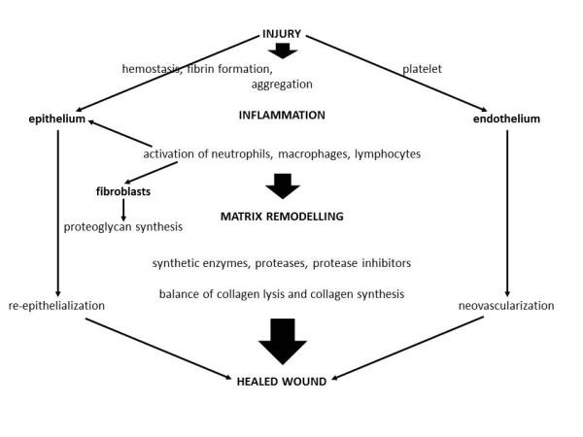
Frank Haubner, Elisabeth Ohmann, Fabian Pohl, Jürgen Strutz and Holger G Gassner. Wound healing after radiation therapy: Review of the literature Radiation Oncology20127:162

Slide 13
Effects on Wound Healing
Reactions usually more severe at appositional skin sites:
Axilla, IMF, groin, perineum
Also involves tissue quality, patient age, medical comorbidities & nutritional status
Early vs Late side-effects

Slide 14
Early RT-Induced Skin Reactions
Occur during radiation therapy or within weeks after
Mainly effects proliferation phase
Single dose (5-8 Gy) can induce transient erythema within 1-2 days, due to capillary congestion
Leads to warm edema & dry or moist desquamation
Hyperpigmentation & hair loss
Due to effect on replicating basal layer of epidermis

Slide 15
Early RT-Induced Skin Reactions
These effects tend to reach a peak and begin to subside before treatment ends
Changes also occur in small vessels & lymphatics
These tend to persist leading to chronic reactions
Cytokine overexpression → → FIBROSIS

Slide 16
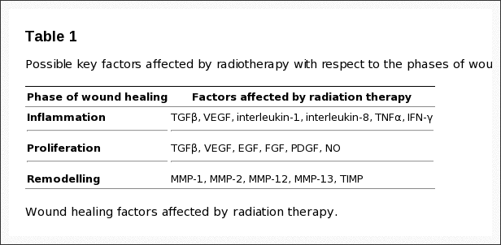

Slide 17
Delayed RT-Induced Reactions
RT has a lasting affect
Effect spans further than DNA level
Affects micro-environment & cell-cell interactions
“Chronic state of genomic instability”
Non-mutagenic effects
Fibrosis & vascular damage
Late findings include skin atrophy, dryness, telangiectasias, dyspigmentation, fibrosis & ulcers
Due to affect on remodeling phase ( MMF’s) → Fibroblasts generate disorganized collagen

Slide 18
Reconstruction Options
Numerous Techniques Exist
Decision Of Which To Use Depends On Desired Breast Size, Severity of Radiation Changes, And Defect Location

Slide 19
Delayed or Secondary Partial Breast Reconstruction
Determine Patient Expectations:
Symmetry
Ideal Breast Volume (Reduction, Reshaping, Augmentation)
Radiation Changes (Mild, Moderate, Severe)

Slide 20
Reconstruction Options
Unfavorable Defects In Smaller Breasts Will Benefit From Volume Replacement Techniques:
Fasciocutaneous or Myocutaneous Flaps
Breast Implant
Fat Grafting
Moderate or Larger Breasts :
Volume Reduction
Volume Displacement Using Local Tissue Rearrangement
Often Requires A Contralatearl Procedure For Symmetry

Slide 21
Fasciocutaneous or Myocutaneous Flaps
Thoracoepigastric Flap
Latissimus /Split Latissimus Flap
Myocutaneous vs Muscle Alone
TRAM flap
SIEA/DIEP/Muscle Sparing TRAM/ Free TRAM

Slide 22
Thoracoepigastric Flap
It Is A Composed of Skin and Adipose Tissue Down To The Fascial Level
It Is An Axial Flap Based On Perforators From the Superior Epigastric Artery By Means Of The Rectus Muscle
It Is Designed Transversely To Take Advantage Of The Medial Blood Supply
Dissection From Lateral To Medial Stopping 2 Cm From Midline To Avoid Damage To Perforating Blood Supply
Most Reliable to the Anterior Axillary Line
Donor Site Can Usually Be Closed Primarily

Slide 25
Latissimus Dorsi Muscle Flap
Reliable, Large, Robust
Used For Large Soft Tissue Defects
Blood Supply From Terminal Branches Of Subscapular Vessels
Type 5 of Mathes and Nahai Flap Classification
May Be Partially Harvested for Smaller Defects
Flap Design May Vary Based On The Defect To Be Reconstructed.

Slide 26
Mathes And Nahai Flap Classification

Slide 28
Fat Grafting
Fat Grafting Has Become Very Popular As We Strive For Better Aesthetic Outcomes And Patient Satisfaction
Most Women Will Tolerate Numerous Secondary Procedures To Achieve The Desired Result
Average Volume Injection Varies From 50 to 100 ml
Most Common Location are the Upper and Inner Quadrant
May Be Utilized To Restore The Entire Breast Volume
Losken A, Pinell XA, Sikoro K, Yezhelyev MV, Anderson E, Carlson GW. Autologous fat grafting in secondary breast reconstruction. Ann Plast Surg. 2011 May;66(5):518-22.

Slide 29
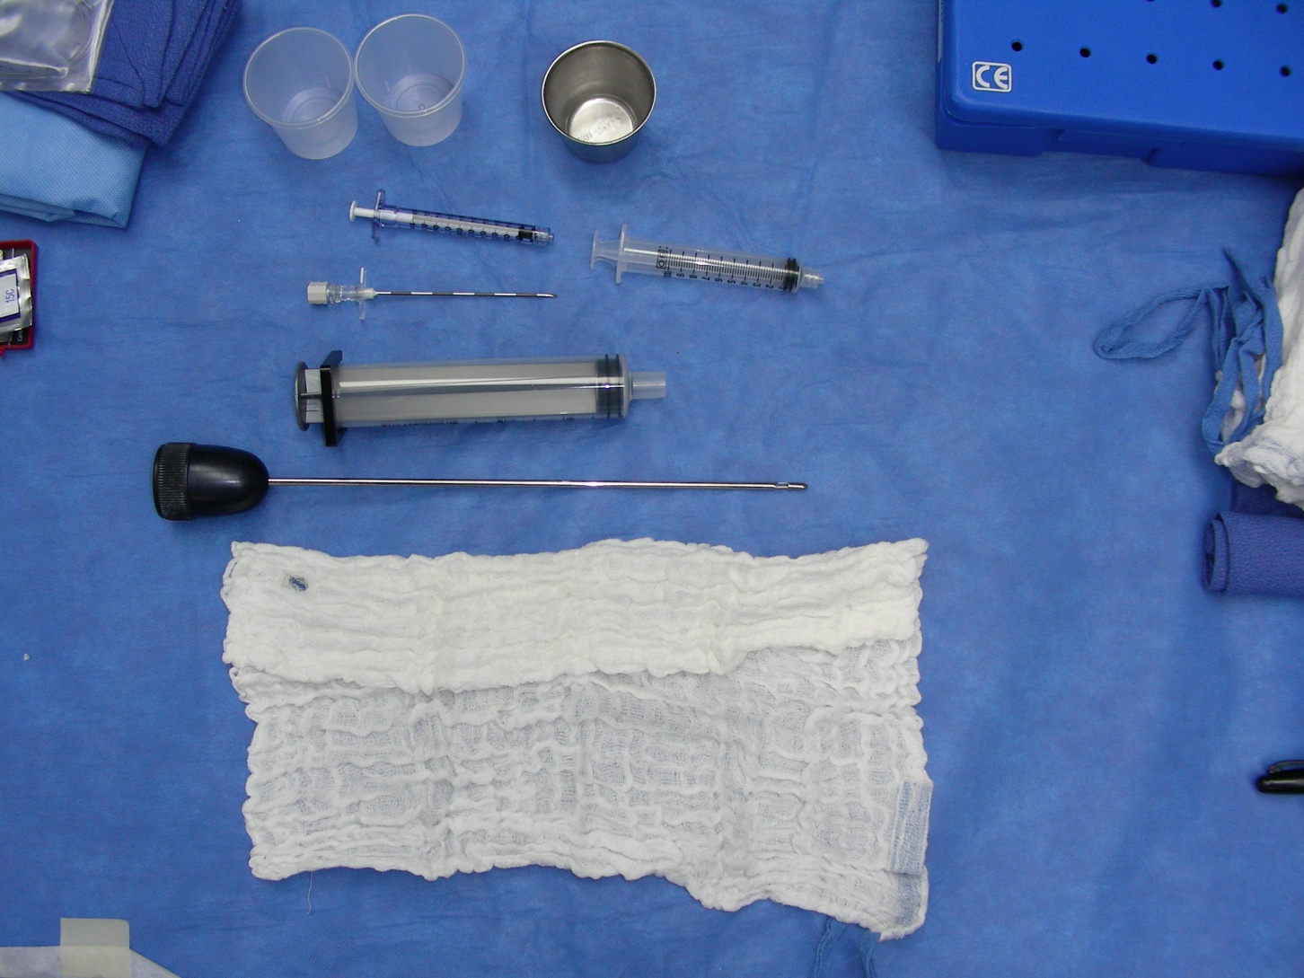

Slide 32
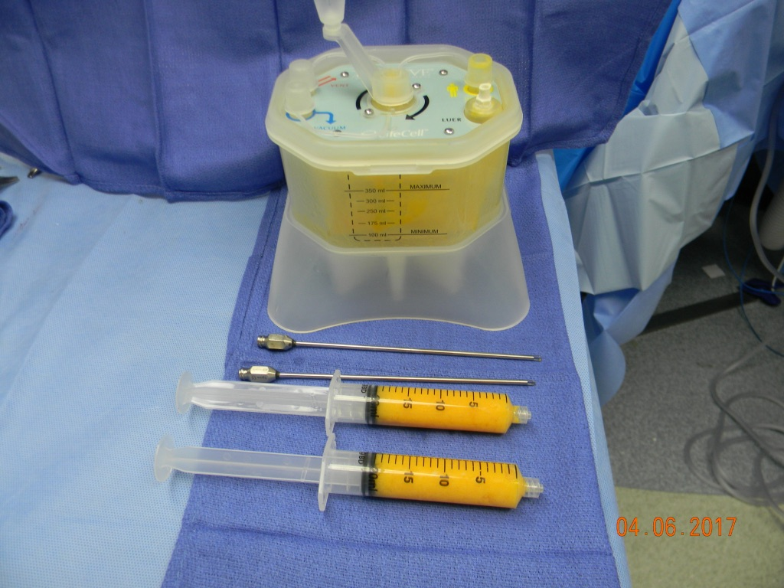
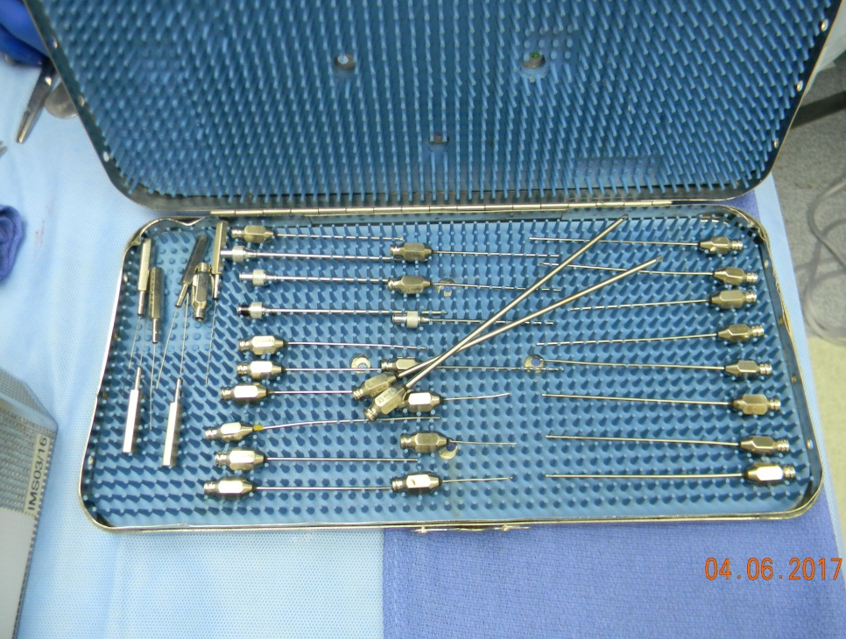
Fat Grafting

Slide 33
Safety of Lipofilling
Concern re. radiologic surveillance by mammography
Discerning malignant calcifications?
Issue largely resolved
Petit et al, Pulagam et al
Concern for oncologic transformation
Pearl et al (2011) reviews stem cell biology & i
ADMSC’s → transform to variety of cell types & secrete angiogenic factors
VEGF known to promote tumor invasion and metastasis in various cancers
Manabe et al – adipocytes increase proliferation of breast cancer cells in vitro

Slide 34
Autologous fat grafting in onco-plastic breast reconstruction: A systematic review on oncological and radiological safety, complications, volume retention and patient/surgeon satisfaction JPRAS: Groen et al (2016)
Literature review
43 studies, two level II, level III & IV, >6K pts
Found no increased risk of cancer recurrence
LRR 2.5% and DR 2.0%
Were lower than cases of mastectomy w/o AFG or BCT w/ RT
Cancer recurrence → SAME histology as primary
RESTORE-2 trial
71 pts got fat grafting after BCT
NO recurrences at 1 year

Slide 35
Lipofilling Of The Breast Does Not Increase The Risk Of Recurrence Of Breast Cancer: A Matched Controlled Study. Kronowitz SJ, Mandujano CC, Kuerer HM, Smith B, Velero V. PRS Feb 2016
LRR 1.3 % On Lipofilling Group vs 2.4 On Control Group

Slide 36
Case Scenarios
50 y/o WF s/p Treatment Of A Left Breast Cancer at the 6 oc Position with Lumpectomy and Radiation

Slide 37
Preop Pictures

Slide 38
Operative Plan

Slide 39
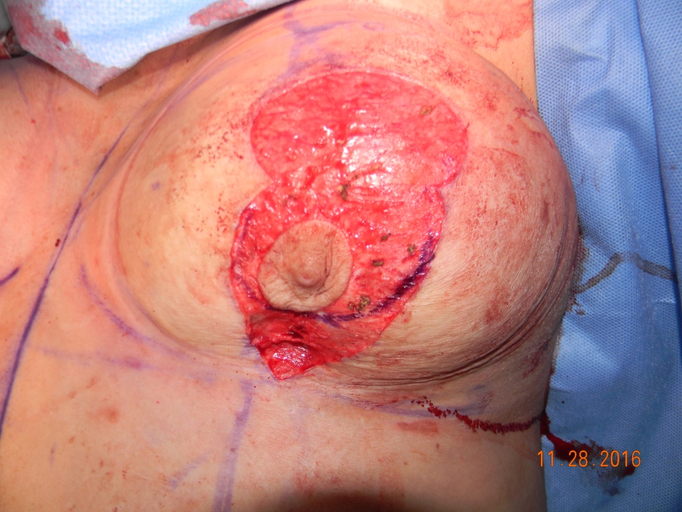
Intra - Operative Pictures

Slide 40
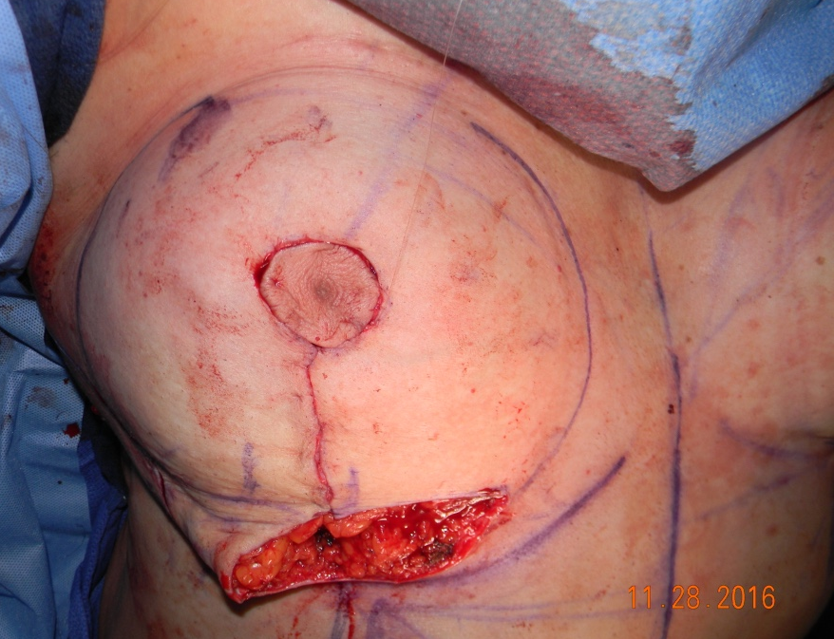
Intra - Operative Pictures

Slide 41
1 Month Postop Pictures

Slide 42
6 Months
Postop Pictures

Slide 44
Case Scenarios
38 y/o WF With History Of Breast Augmentation Prior To Treatment Of A Right Central Breast Cancer with Lumpectomy and Radiation

Slide 45
Preop Pictures

Slide 46
Intra - Operative Pictures

Slide 47
1 Month
Postop Pictures

Slide 48
6 Months Postop Pictures

Slide 49
Case Scenarios
55 y/o WF With A New Left Breast Cancer

Slide 50
Lumpectomy + Local Tissue Rearrangement + Contralateral Reduction For Symmetry

Slide 51
Case Scenarios
35 y/o WF With A Left Breast Phyllodes Tumor

Slide 52
Left Lumpectomy + LTR + Breast Augmentation

Slide 53
Conclusion
Understand Patient Expectations:
Symmetry
Ideal Breast Volume
Define Outcome Limitations:
Radiation Changes
Personalize Patient Patient Care By Matching Reconstruction Options To Patients Desire

Slide 54
Thank You

